Slide 1

Trajectory Data Mining: An Overview

Slide 2
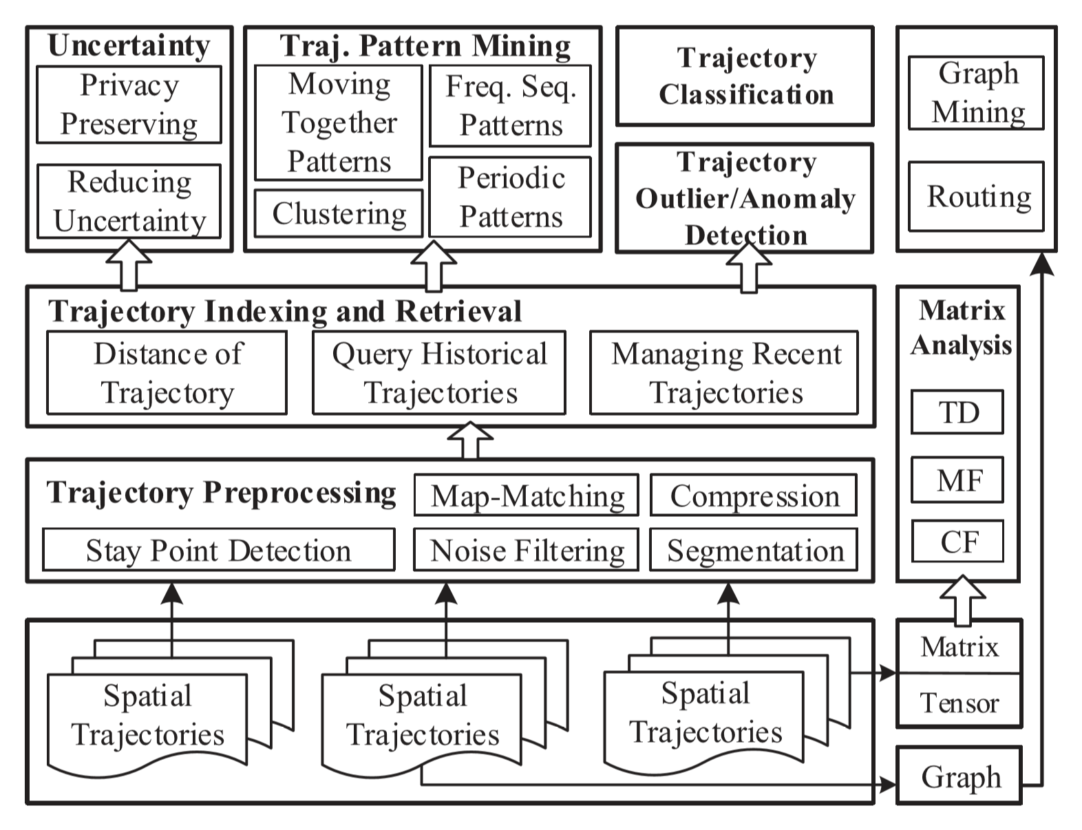
Trajectory Data Mining

Slide 3
Trajectory Data Mining
Mining Goals
Trajectory Uncertainty
Filling the gap between two trajectory records – filling unknown trajectory data
Trajectory Pattern Mining
Moving together patterns
Trajectory clustering
Periodic patterns
Frequent sequential patterns
Trajectory Classification
i.e. activities – transportation modes - …
Trajectory Outlier Detection

Slide 4
Trajectory Data Mining
Data Collection
Mobility of people:
Active recording – Passive recording
Mobility of transportation vehicles:
Taxis, buses, airplanes, …
Mobility of animals:
Animal migration, behavior, …
Mobility of natural phenomena:
Hurricanes, tornados, ocean flows, floods, …

Slide 5
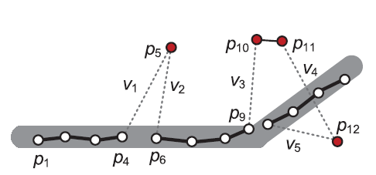
Trajectory Data Mining
Preprocessing
Noise Filtering
Mean/median filter
Kalman and Particle filters
Heuristic-Based outlier detection
Speed threshold (e.g. 150 mph)
Stay point detection
Map Matching

